Slide 1
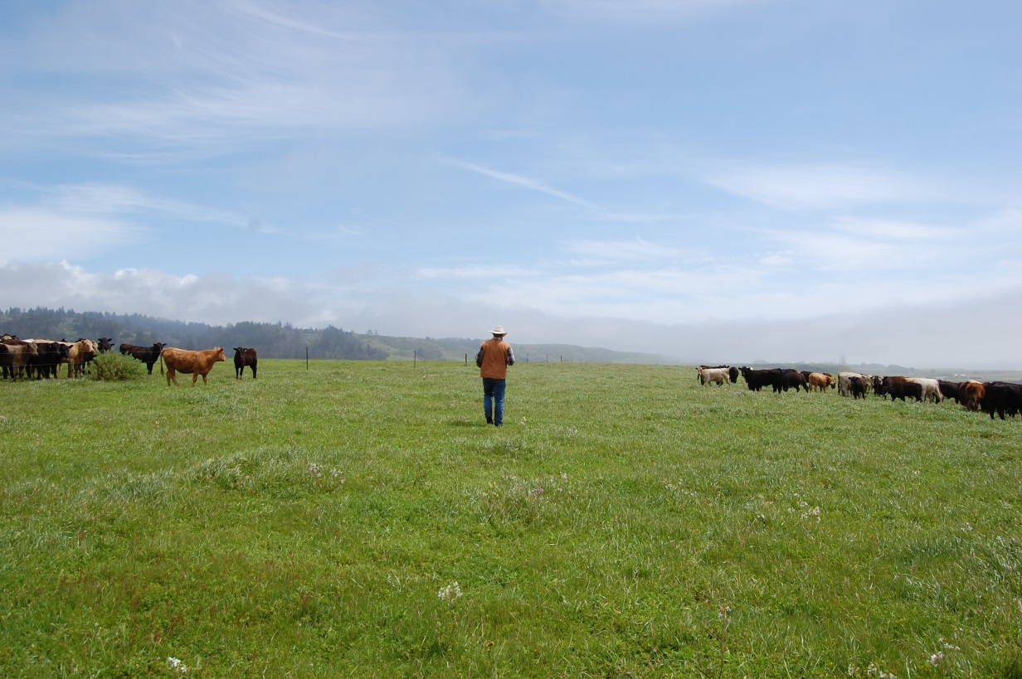
Carbon Farm Planning
Site specific comprehensive plans for farms and ranches
Store carbon in soils and vegetation
Reduce greenhouse gas emissions
Quantify carbon benefits
Co-benefits
Utilizes NRCS conservation planning
Carbon lens
Notes:
Site specific comprehensive plans for farms and ranches
Identify opportunities to Store carbon in soils and vegetation
And Reduce greenhouse gas emissions
Quantify carbon benefits of those practices, and other conservation practices
Identify Co-benefits
Utilizes NRCS conservation planning process which is used to develop conservation plans for property owners and is required for NRCS farm bill funding assistance
Carbon lens
Because of that we’ve decided to call them Conservation-Carbon plans in San Mateo.

Slide 2
Steps
1. Inventory resources
2. Identify and quantify potential carbon benefits & Identify potential co-benefits
3. Develop plan with landowner
4. Implement plan and evaluate
Notes:
Here are the basic steps we go through to create a carbon farm plan

Slide 3
Steps
1. Inventory resources
2. Identify and quantify potential carbon benefits & Identify potential co-benefits
3. Develop plan with landowner
4. Implement plan and evaluate
Notes:
Talk about the first two in greater detail.

Slide 4
Inventory Resources
Resource concerns
Vegetation types
Species of special concern: vegetation, wildlife, invasives
Ecological sites: Aspect, elevation, slope, soil
Erosion/sedimentation
Land management and agricultural production practices
Access: cattle, equipment
Soil carbon/organic matter
Goals for property and operation
Historical land use
Existing conservation and carbon farming practices
Notes:
Step 1 is to Inventory resources
Rely on the expertise of the landowner/manager, who are on the ground and in the field everyday. Site visits. Collaborative process.
Landowner: resource concerns, goals, ranching/farming practices, historical land use
Also vegetation, wildlife, aspect, slope, soil, erosion, soil organic matter, habitat conditions, equipment access, crop production,

Slide 5
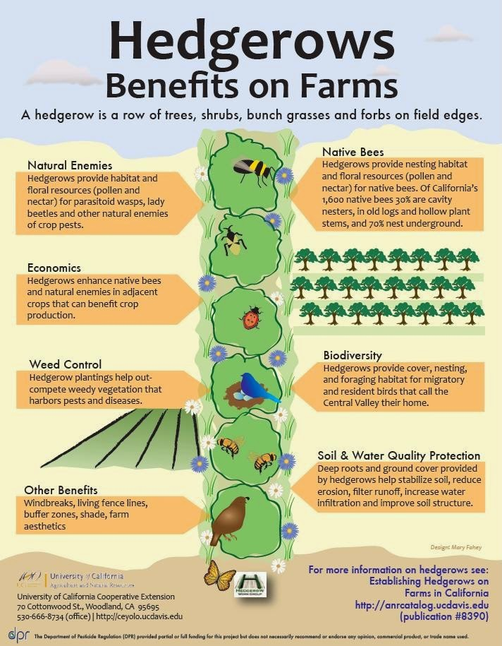
Practices
Plans recommend site-specific practices (NRCS & other), e.g.:
Rangeland Compost
Pasture Cropping
Biochar Soil Amendment
Anaerobic Digester
Silvopasture
Forage and Biomass Planting
Nutrient Management
Tree/Shrub Establishment
Forest Stand Improvement
Contour Buffer Strips
Riparian Restoration
Riparian Forest Buffer
Riparian Herbaceous Cover
Vegetative Barrier
Hedgerow/ Windbreak/Shelterbelt Establishment
Residue and Tillage Management, No Till/Strip
Till/Direct Seed
Multi-Story Cropping
Alley Cropping
Range Planting
Herbaceous Wind Barriers
Critical Area Planting
Residue and Tillage Management
Forest Slash Treatment
Filter Strip
Grassed Waterway
Cross Wind Trap Strips Conservation Cover
Wetland Restoration
Notes:
Step 2: Identify and quantify potential carbon benefits & Identify potential co-benefits
recommended practices based on site conditions and input from landowner.
Primarily recommending practices which have been approved by the NRCS for conservation plans and NRCS has identified these practices has having carbon benefits.
Also recommending practices that are not NRCS listed, but have proved carbon benefits, like compost application on rangeland, which Dr. Creque talked about.
Most common plans being recommended so far have been compost or mulch application, rangeland plantings, riparian forest buffers, hedgerows

Slide 6
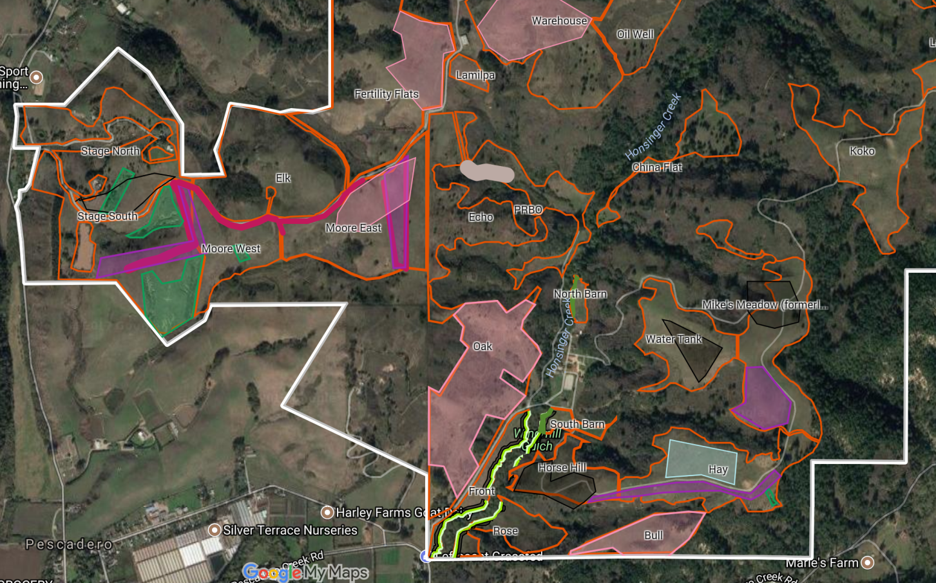
Quantifying Carbon
Notes:
Carbon Farm Plan in practice

Slide 7
Quantifying Carbon
Notes:
After mapping, we quantify the carbon benefits of the recommended practices based on the site and scale of the practice.
For example, a ¼” application of compost on pasture has the potential to sequester nearly 1.5 metric tonnes of CO2 equivalent per acre per year, so the 10 acre application in “Mikes Meadow” would capture 14.9 CO2e tonnes/year.
Bottom section: practices without a quantifiable carbon benefit. May not have direct carbon benefit, but have indirect carbon benefits. For example, testing coyote brush control with goats would reduce GHG emissions from annual mowing. Or repairing a road may lead to the ability to do conservation grazing on a pasture that is continuously grazed because it is too difficult to access.

Slide 8
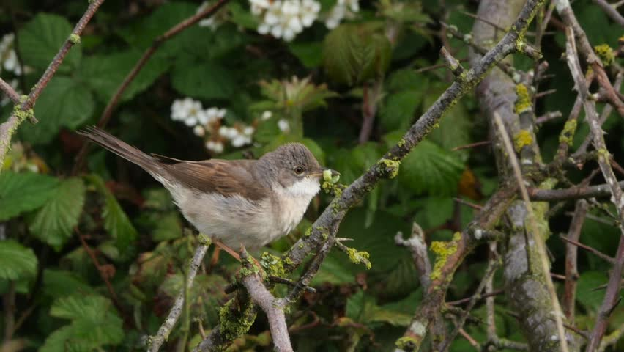
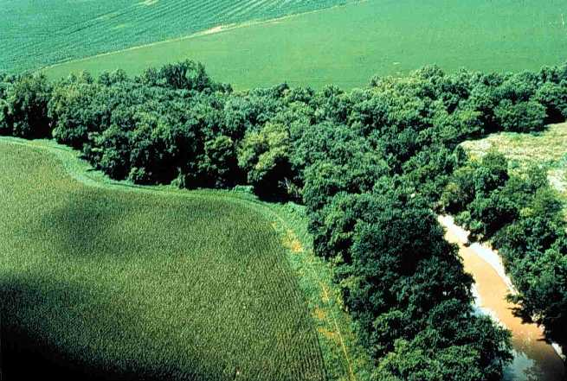
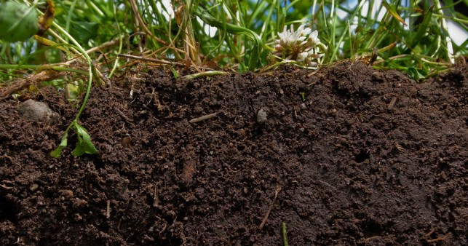
Co-Benefits
Avoided emissions
Habitat structural and species diversity
Improved water holding capacity
Improved soil quality and fertility
Improved water quality
Reduction in erosion and sedimentation
Increased soil depth
Notes:
Many of the practices recommended for carbon farming have many co-benefits, which will benefit the farming or ranching operation, like improved water holding capacity of soils, improved forage, and soil fertility
Other practices have larger benefits that will be felt beyond those property lines- like building habitat or improving water quality.

Slide 9
Steps
1. Inventory resources
2. Identify and quantify potential carbon benefits & Identify potential co-benefits
3. Develop plan with landowner
Tradeoffs
Feasibility
Prioritize
Funding
4. Implement plan and evaluate
Notes:
3. Develop plan.
Another collaborative step.
Weighing trade offs of practices and how they may impact or benefit the operation:
-TomKat: Recommended silvopasture for a pasture. Learned from Point Blue, who partners with TomKat, that the recommended area was prime habitat for a protected bird
-Most feasibility issues that have come up for us are around access. So like I mentioned before, road issues that would prevent equipment access. Or even quantity of compost in SMC has been an issue.
We also make recommendations on prioritization of practices in our plans and potential funding assistance for implementation.
Since we have relationships with so many farms and ranches, we know what projects need to be implemented, so we stay in touch often around funding opportunities.
4. Implement plan and evaluate the success of the practices.
These are meant to be living documents, to be updated as operations and conditions change.

Slide 10
Notes:
Important to acknowledge the work that has been done on the properties prior to the plan.
A lot of work is already being implemented on these properties, especially TomKat Ranch who has a goal of conservation, just before the work wasn’t being as carbon farming. We think its important to acknowledge and quantify, when possible, the work that has already been done.

Slide 11
Steps
1. Inventory resources
2. Identify and quantify potential carbon benefits & Identify potential co-benefits
3. Develop plan with landowner
4. Implement plan and evaluate

Slide 12
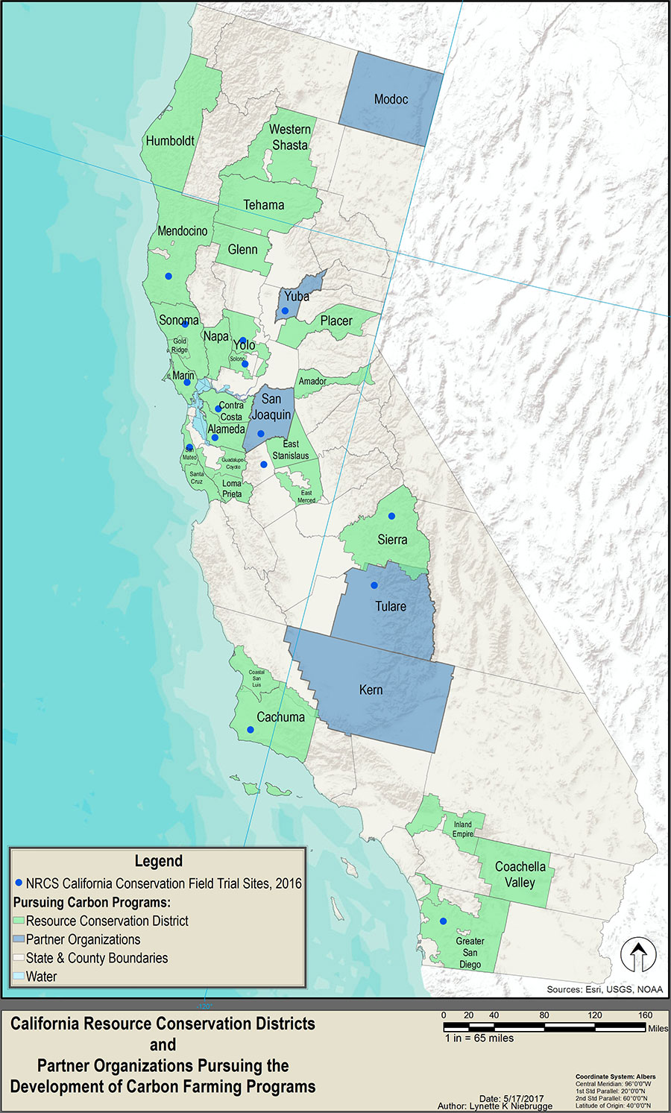
Our Program
Current funding is for a regional partnership: NRCS and RCDs of Marin, Sonoma, Napa, and Solano, and Marin Agricultural Land Trust
Larger network of RCDs involved in building a state wide network to be able to offer these services for working lands across the state
Notes:
Currently, the funding for this work is a partnership grant with the NRCS and other RCDs around the Bay Area and Marin Agricultural Land Trust, who has been involved in carbon farming with Marin RCD and Marin Agricultural Land Trust.
RCDs across the state have been participating in trainings, and building a network to be able to provide carbon farm planning and assistance for working lands across California. If you’re interested in creating a plan or learning more I encourage you to reach out to your local RCD or Californica association of RCDs.

Slide 13
Our Program
In SMC:
Five plans complete or underway
First three= 3,800 acres, ~400 CO2e annually
Over 53,000 acres suitable
Work with land trusts:
Two plans currently underway with local
open space trust
Partners in SMC:
Notes:
In SMC:
Five plans complete or underway
First three= 3,800 acres, ~400 CO2e annually
Over 53,000 acres suitable
Work with land trusts:
Two plans currently underway with local
open space trust
1 is working ranch, and 1 has both ranching and row crops.
Locally we work with NRCS, whom which we have a partnership office.
Carbon cycle institute who has been advising us.
TomKat Ranch Educational Foundation
And we have been using data from Point Blue’s rangeland monitoring network, who has a station at TomKat.

